Slide 1
Clustering
CMPUT 466/551
Nilanjan Ray

Slide 2
What is Clustering?
Attach label to each observation or data points in a set
You can say this “unsupervised classification”
Clustering is alternatively called as “grouping”
Intuitively, if you would want to assign same label to a data points that are “close” to each other
Thus, clustering algorithms rely on a distance metric between data points
Sometimes, it is said that the for clustering, the distance metric is more important than the clustering algorithm

Slide 3
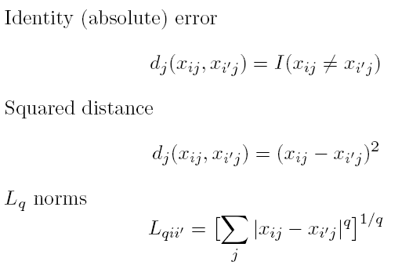

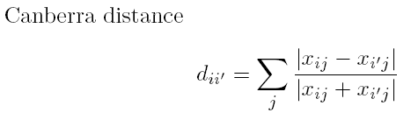
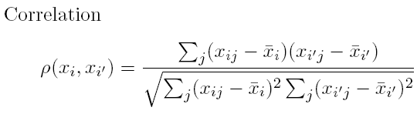
Distances: Quantitative Variables
Data point:
Some examples

Slide 4
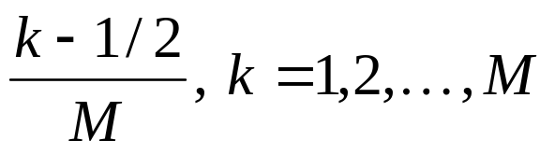
Distances: Ordinal and Categorical Variables
Ordinal variables can be forced to lie within (0, 1) and then a quantitative metric can be applied:
For categorical variables, distances must be specified by user between each pair of categories.

Slide 5
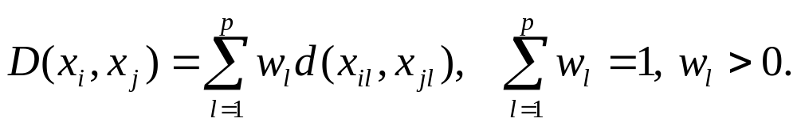
Combining Distances
Often weighted sum is used:

Slide 6
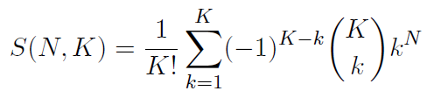
Combinatorial Approach
In how many ways can we assign K labels to N observations?
For each such possibility, we can compute a cost. Pick up the assignment with best cost.
Formidable number of possible assignments:
(I’ll post a page about the origin of this formula)

Slide 7
K-means Overview
An unsupervised clustering algorithm
“K” stands for number of clusters, it is typically a user input to the algorithm; some criteria can be used to automatically estimate K
It is an approximation to an NP-hard combinatorial optimization problem
K-means algorithm is iterative in nature
It converges, however only a local minimum is obtained
Works only for numerical data
Easy to implement

Slide 8
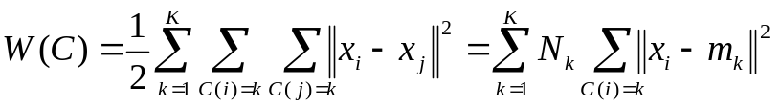
K-means: Setup
x₁,…, x_{N} are data points or vectors of observations
Each observation (vector x_{i}) will be assigned to one and only one cluster
C(i) denotes cluster number for the i^{th} observation
Dissimilarity measure: Euclidean distance metric
K-means minimizes within-cluster point scatter:
(Exercise)
where
m_{k} is the mean vector of the k^{th} cluster
N_{k} is the number of observations in k^{th} cluster

Slide 9
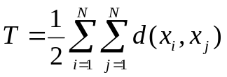
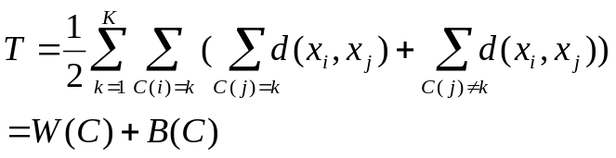
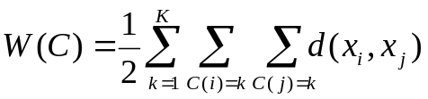
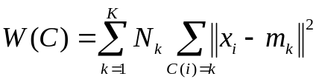
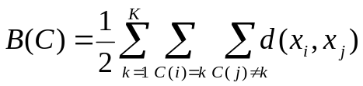
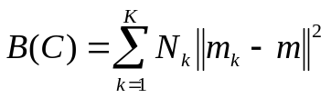
Within and Between Cluster Criteria
Let’s consider total point scatter for a set of N data points:
Distance between two points
T can be re-written as:
If d is square Euclidean distance, then
Where,
Within cluster
scatter
and
Ex.
Between cluster
scatter
Grand mean
Minimizing W(C) is equivalent to maximizing B(C)

Slide 10
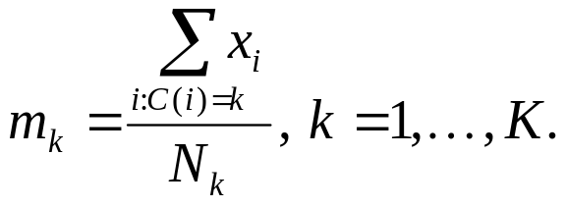
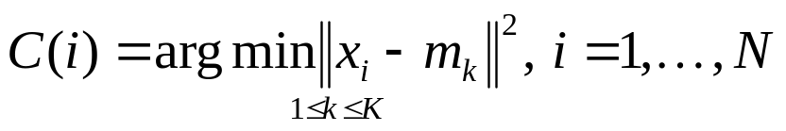
K-means Algorithm
For a given cluster assignment C of the data points, compute the cluster means m_{k}:
For a current set of cluster means, assign each observation as:
Iterate above two steps until convergence

Slide 11
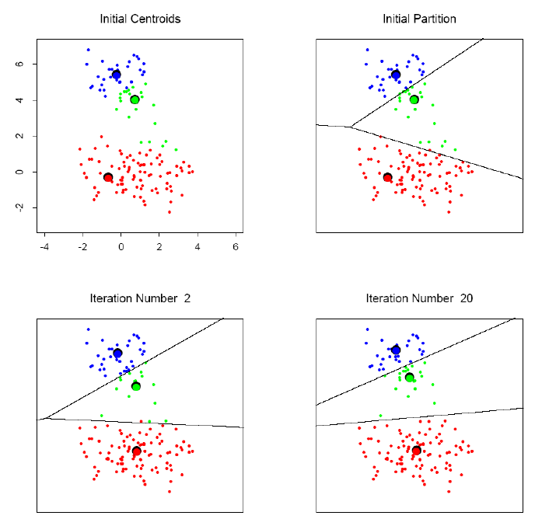
K-means clustering example

Slide 12
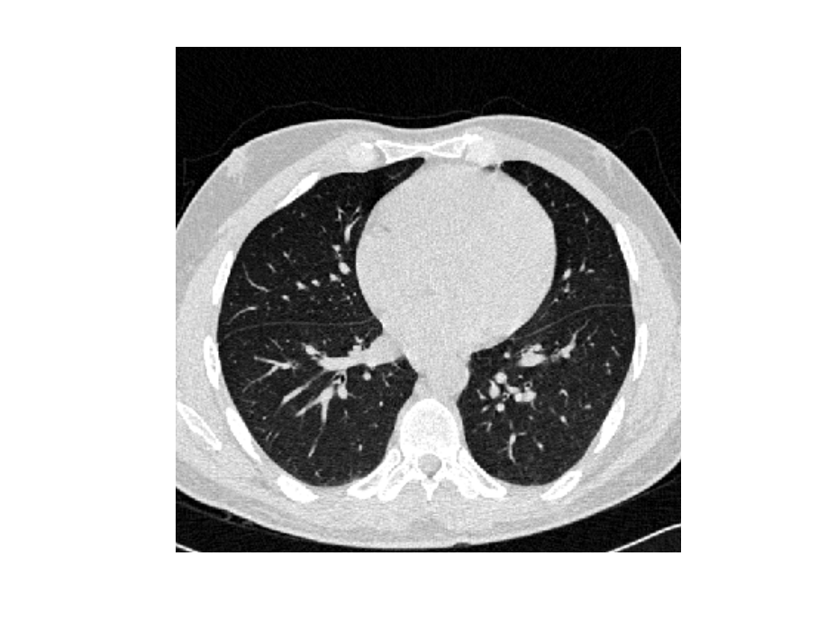
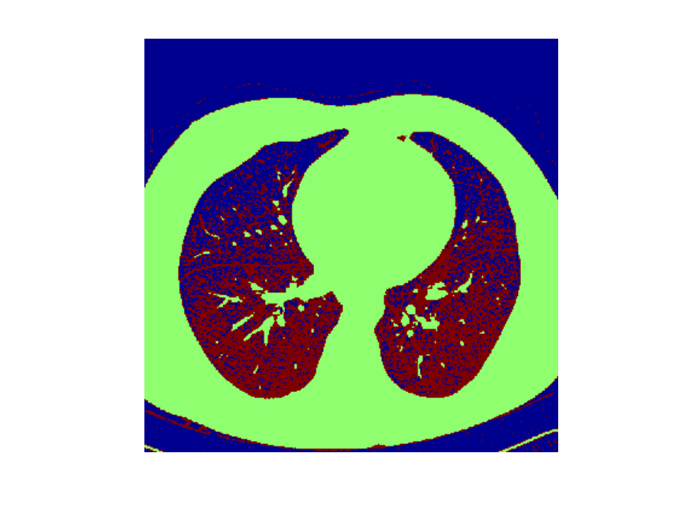
K-means Image Segmentation
An image (I)
Three-cluster image (J) on
gray values of I
Matlab code:
I = double(imread(‘…'));
J = reshape(kmeans(I(:),3),size(I));
Note that K-means result is “noisy”

Slide 13
K-means: summary
Algorithmically, very simple to implement
K-means converges, but it finds a local minimum of the cost function
Works only for numerical observations
K is a user input; alternatively BIC (Bayesian information criterion) or MDL (minimum description length) can be used to estimate K
Outliers can considerable trouble to K-means

Slide 14
K-medoids Clustering
K-means is appropriate when we can work with Euclidean distances
Thus, K-means can work only with numerical, quantitative variable types
Euclidean distances do not work well in at least two situations
  Some variables are categorical
  Outliers can be potential threats
A general version of K-means algorithm called K-medoids can work with any distance measure
K-medoids clustering is computationally more intensive

Slide 15
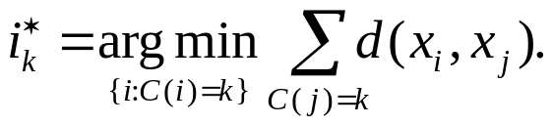

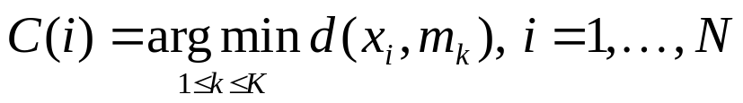
K-medoids Algorithm
Step 1: For a given cluster assignment C, find the observation in the cluster minimizing the total distance to other points in that cluster:
Step 2: Assign
Step 3: Given a set of cluster centers {m₁, …, m_{K}}, minimize the total error by assigning each observation to the closest (current) cluster center:
Iterate steps 1 to 3

Slide 16
K-medoids Summary
Generalized K-means
Computationally much costlier that K-means
Apply when dealing with categorical data
Apply when data points are not available, but only pair-wise distances are available
Converges to local minimum

Slide 17
Choice of K?
Can W_{K}(C), i.e., the within cluster distance as a function of K serve as any indicator?
Note that W_{K}(C) decreases monotonically with increasing K. That is the within cluster scatter decreases with increasing centroids.
Instead look for gap statistics (successive difference between W_{K}(C)):

Slide 18
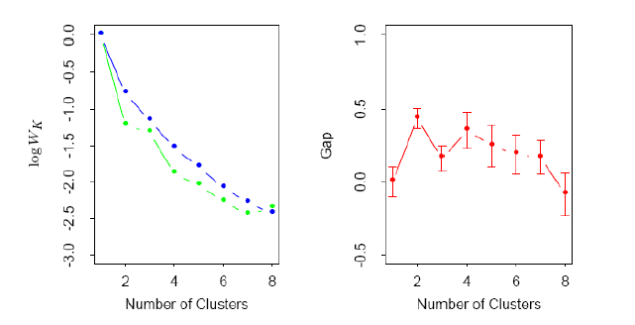
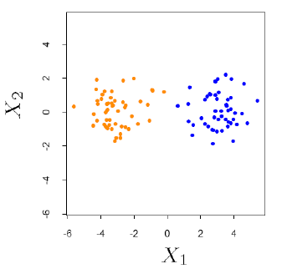
Choice of K…
Data points simulated
from two pdfs
Log(W_{K}) curve
Gap curve
This is essentially a visual heuristic

Slide 19
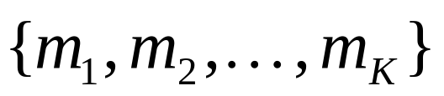
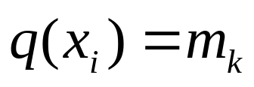
Vector Quantization
A codebook (a set of centroids/codewords):
A quantization function:
K-means can be used to construct the codebook
Often, the nearest-neighbor function

Slide 20
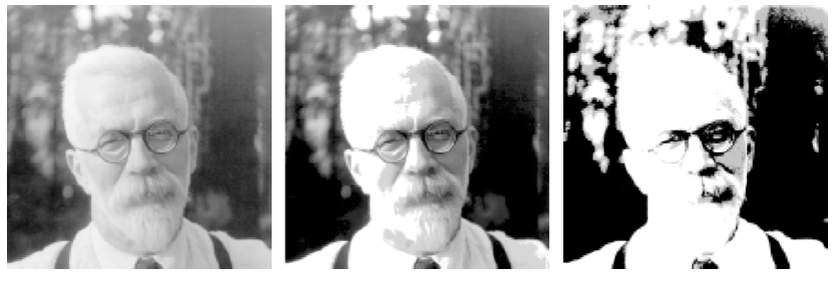
Image Compression by VQ
8 bits/pixel
1.9 bits/pixel,
using 200 codewords
0.5 bits/pixel,
using 4 codewords

Slide 21
Otsu’s Image Thresholding Method
Based on the clustering idea: Find the threshold that minimizes the weighted within-cluster point scatter.
This turns out to be the same as maximizing the between-class scatter.
Operates directly on the gray level histogram [e.g. 256 numbers, P(i)], so it’s fast (once the histogram is computed).

Slide 22
Otsu’s Method…
Histogram (and the image) are bimodal.
No use of spatial coherence, nor any other notion of object structure.
Assumes uniform illumination (implicitly), so the bimodal brightness behavior arises from object appearance differences only.

Slide 23
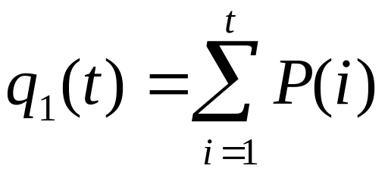
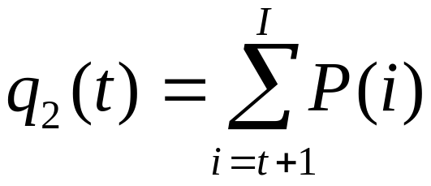
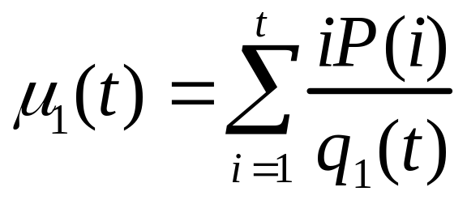
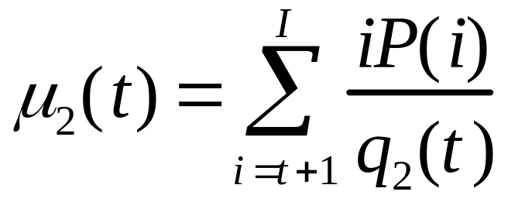
The weighted within-class variance is:
Where the class probabilities are estimated as:
And the class means are given by:

Slide 24
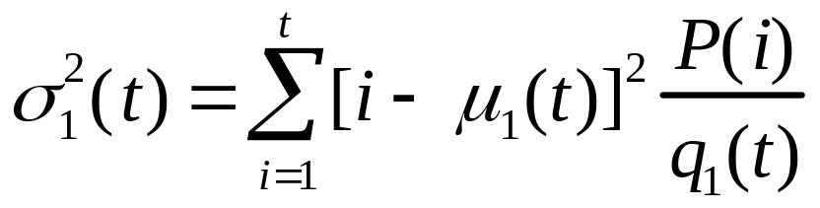
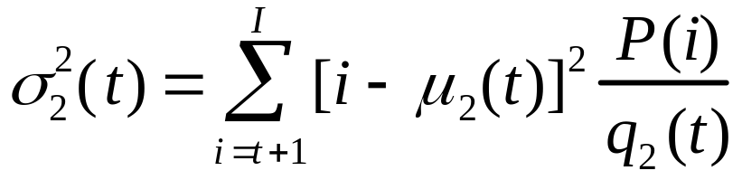

Finally, the individual class variances are:
Now, we could actually stop here. All we need to do is just run through the full range of t values [1, 256] and pick the value that minimizes .
But the relationship between the within-class and between-class variances can be exploited to generate a recursion relation that permits a much faster calculation.

Slide 25
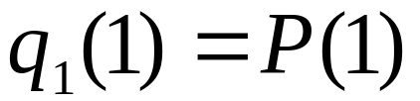
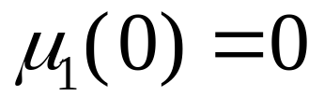
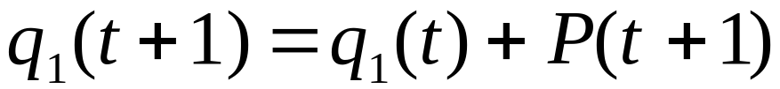
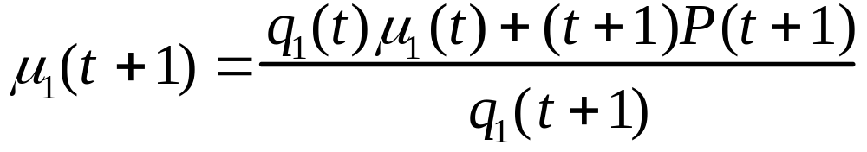
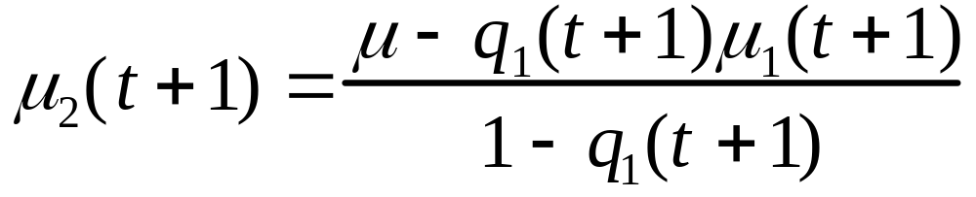
Finally...
Initialization...
;
Recursion...

Slide 26

After some algebra, we can express the total variance as...
Within-class,
from before
Between-class,
Since the total is constant and independent of t, the effect of changing the threshold is merely to move the contributions of the two terms back and forth.
So, minimizing the within-class variance is the same as maximizing the between-class variance.
The nice thing about this is that we can compute the quantities in recursively as we run through the range of t values.

Slide 27

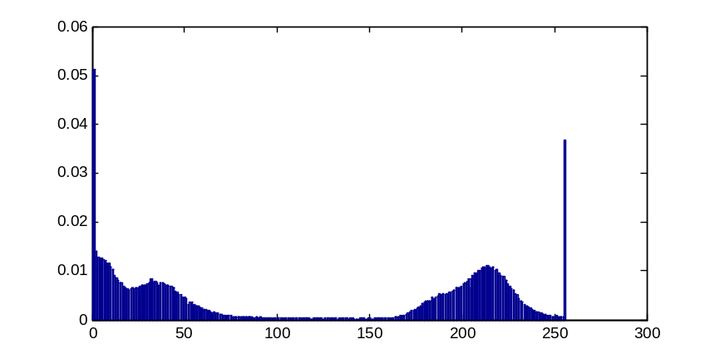
Result of Otsu’s Algorithm
An image
Binary image
by Otsu’s method
Matlab code:
I = double(imread(‘…'));
I = (I-min(I(:)))/(max(I(:))-min(I(:)));
J = I>graythresh(I);
Gray level histogram

Slide 28
Hierarchical Clustering
Two types: (1) agglomerative (bottom up), (2) divisive (top down)
Agglomerative: two groups are merged if distance between them is less than a threshold
Divisive: one group is split into two if intergroup distance more than a threshold
Can be expressed by an excellent graphical representation called “dendogram”, when the process is monotonic: dissimilarity between merged clusters is increasing. Agglomerative clustering possesses this property. Not all divisive methods possess this monotonicity.
Heights of nodes in a dendogram are proportional to the threshold value that produced them.

Slide 29
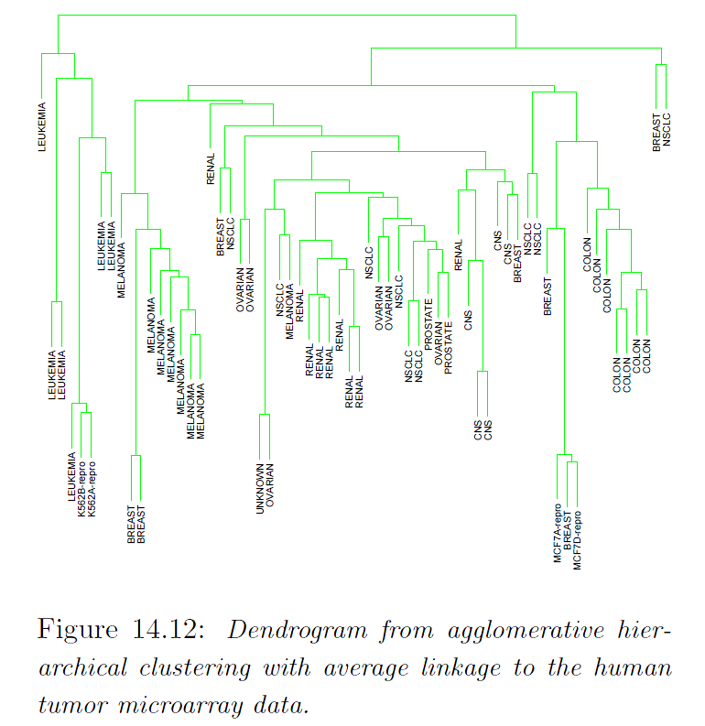
An Example Hierarchical Clustering

Slide 30
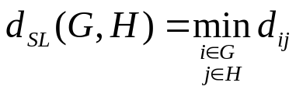
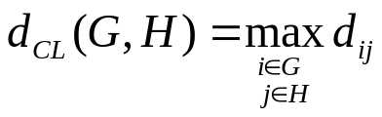
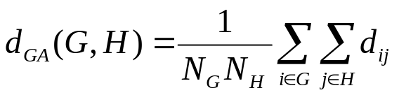
Linkage Functions
Linkage functions computes the dissimilarity between two groups of data points:
Single linkage (minimum distance between two groups):
Complete linkage (maximum distance between two groups):
Group average (average distance between two groups):

Slide 31
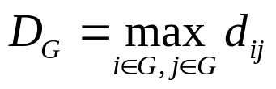
Linkage Functions…
SL considers only a single pair of data points; if this pair is close enough then action is taken. So, SL can form a “chain” by combining relatively far apart data points.
SL often violates the compactness property of a cluster. SL can produce clusters with large diameters (D_{G}).
CL is just the opposite of SL; it produces many clusters with small diameters.
CL can violate “closeness” property- two close data points may be assigned to different clusters.
GA is a compromise between SL and CL

Slide 32
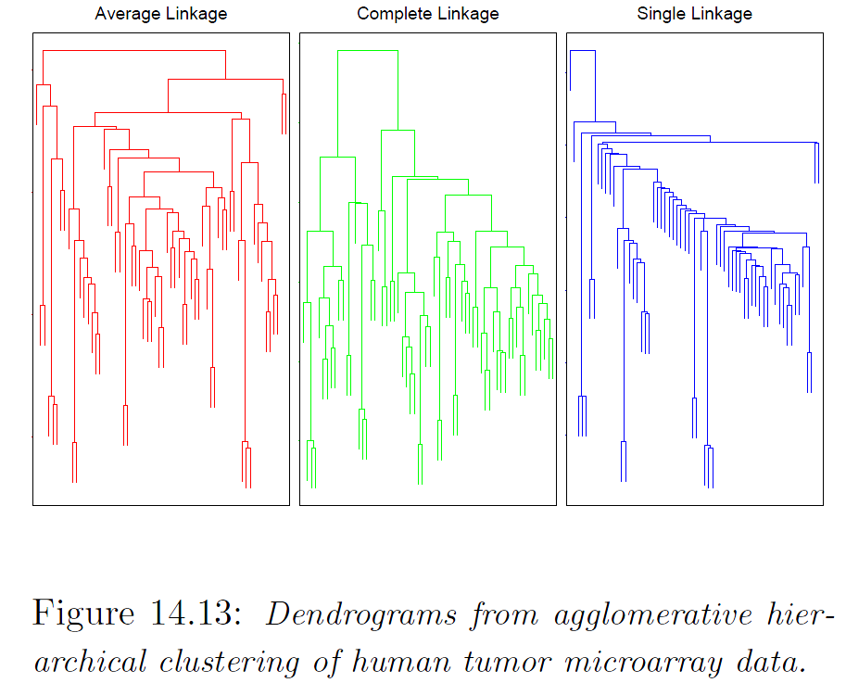
Different Dendograms

Slide 33
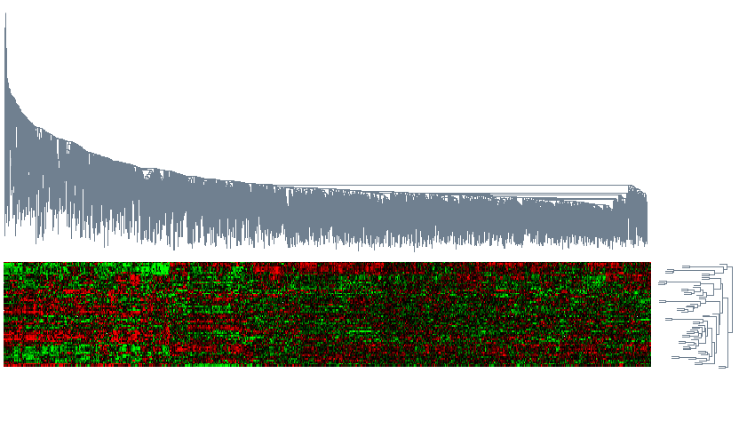
Hierarchical Clustering on Microarray Data

Slide 34
Hierarchical Clustering Matlab Demo

